Slide 1
RADIAL COLUMN CHART

Slide 2
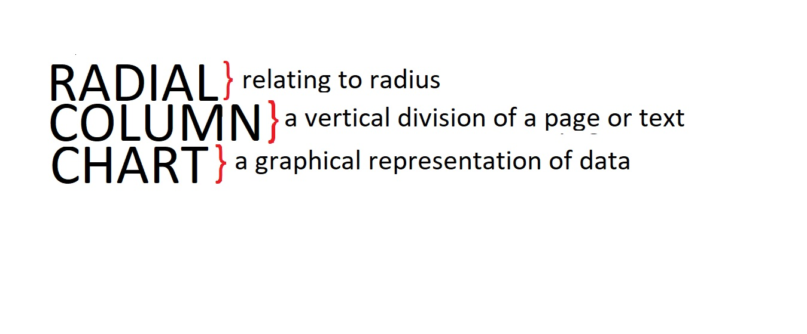
DEFINITION

Slide 3
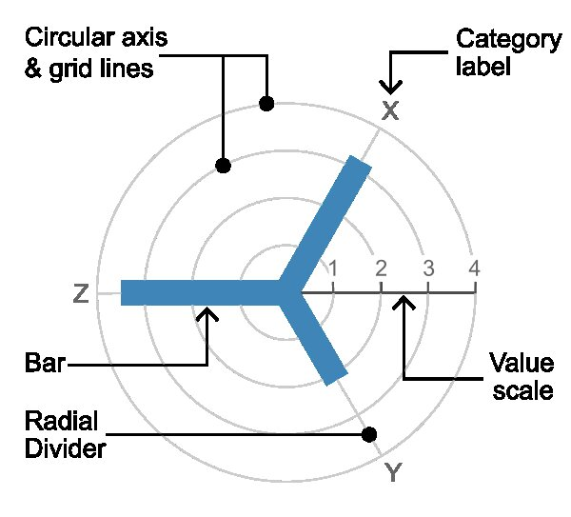
DIAGRAM

Slide 4
DESCRIPTION
Circular Column Graph or Star Graph.
Uses a grid of concentric circles to plot bars on.
Each circle on the graph represents a value on a scale
Radial dividers are used for each category or interval

Slide 5
PROS & CONS
Can represent both Positive & Negative values.
Can get messy soon if there are large number of categories.
Not widely known.

Slide 6
THANK YOU!!!

